Slide 1
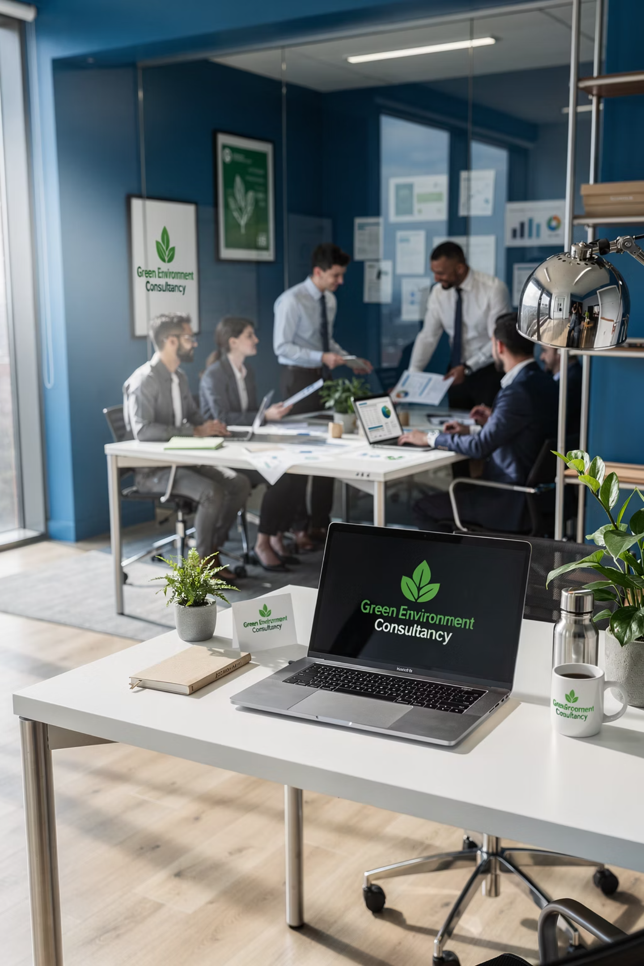
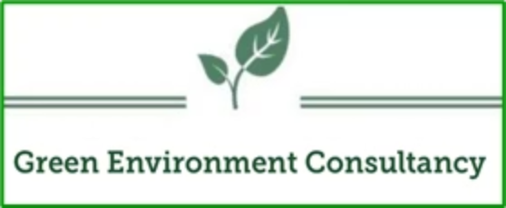
Green Environment Consultancy
Environmental Leadership | Regulatory Excellence | Sustainable Solutions
GRADE A CERTIFIED
KUWAIT EPA APPROVED

Slide 2
Your Environmental Partner in Kuwait
Green Environment Consultancy is a Grade (A) registered environmental consulting firm licensed by the Kuwait Environment Public Authority (KEPA). We deliver integrated environmental solutions that enable organizations to balance economic growth with environmental stewardship and full regulatory compliance.
Contact Information
Location: Mazaya Tower 1, 15th Floor, Kuwait City
Phone: +965 22245887
Our comprehensive services support government entities, industrial operations, infrastructure developments, hospitality sectors, and commercial enterprises throughout Kuwait. We combine technical excellence with deep regulatory knowledge to help clients navigate complex environmental challenges.
Mobile: +965 95575534 - +965 92232178
Email: info@envo-green.com
Website: www.envo-green.com

Slide 3
Vision & Mission
Our Vision
Our Mission
To lead the environmental consulting sector in Kuwait by delivering high-quality, ethical, and technically advanced environmental solutions that set industry standards and drive sustainable development across all sectors.
To enhance environmental performance throughout Kuwait by providing state-of-the-art consultancy services aligned with Environmental Protection Law No. 42 of 2014 and its amendments (Law No. 99 of 2015), ensuring regulatory compliance and environmental excellence.

Slide 4
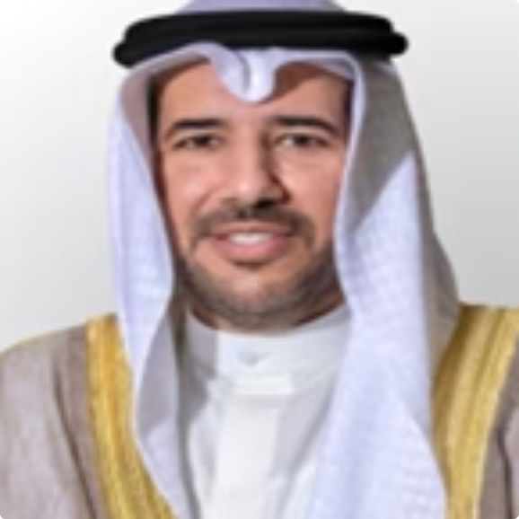

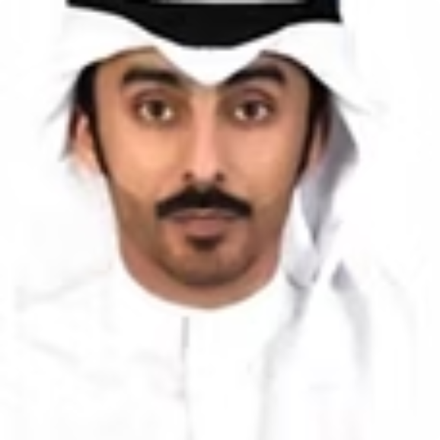
Leadership Excellence
Our leadership team brings unparalleled experience in environmental governance, regulatory development, and technical execution. This unique combination of government authority, academic expertise, and practical engineering knowledge positions us as Kuwait's premier environmental consultancy.
H.E. Sheikh Abdullah Ahmad Al-Humoud Al-Sabah
Dr. Meshari S. Almutairi
Eng. Meshaal S. Almutairi
Board Member
Board Member & Executive Director
Chairman
Professor of Environmental Engineering at Abdullah Al Salem University. Environmental Advisor to SLB Kuwait and former Environmental Advisor to Kuwait National Assembly. Brings cutting-edge academic research to practical applications.
Environmental practice expert with mechanical engineering background. Founder of Grade (B) environmental company with proven track record in project execution and client relationship management.
Former Director General and Chairman of Kuwait Environment Public Authority. Recognized leader in environmental governance and regulatory development with extensive experience shaping Kuwait's environmental policy framework.

Slide 5
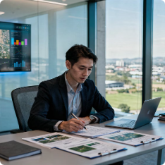
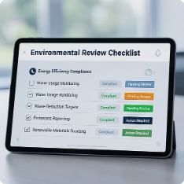
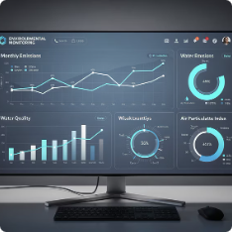
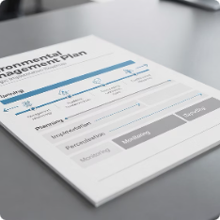
Comprehensive Environmental Studies
We deliver thorough environmental assessments that form the foundation for informed decision-making and regulatory approval. Our studies combine rigorous scientific methodology with practical recommendations tailored to Kuwait's unique environmental conditions.
Environmental Impact Assessment (EIA)
Environmental Review Assessment (ERA)
Compliance Monitoring & Reporting
Environmental Management Plans (EMP)
Comprehensive evaluation of proposed projects to identify, predict, and mitigate environmental impacts. Full compliance with KEPA requirements for all project scales.
Streamlined assessment process for lower-risk activities, ensuring efficient regulatory approval while maintaining environmental protection standards.
Monthly and annual compliance reports that track environmental performance, demonstrate regulatory adherence, and provide actionable insights for continuous improvement.
Detailed operational frameworks that guide project implementation, establish monitoring protocols, and ensure ongoing environmental responsibility throughout project lifecycle.

Slide 6
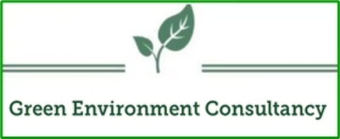
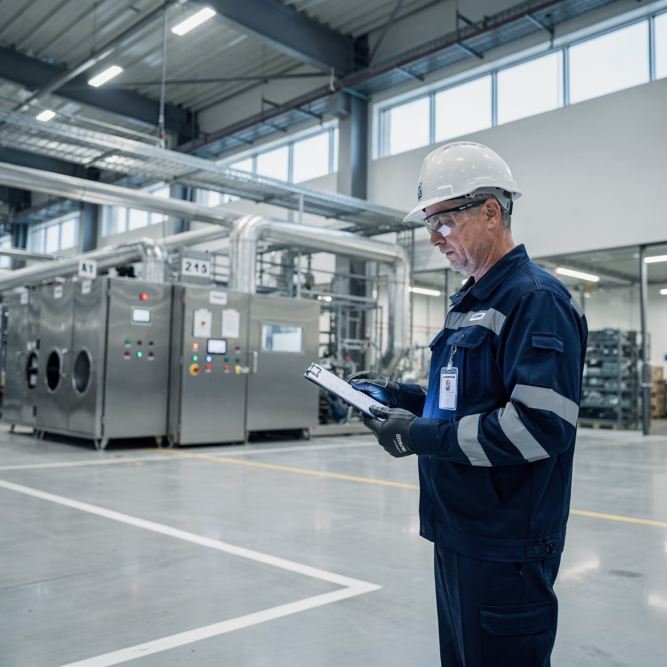




Health, Safety & Environment (HSE) Services
Our HSE services protect your workforce, minimize operational risks, and ensure full compliance with Kuwait's occupational health and environmental regulations. We develop practical, implementable systems that integrate seamlessly with your operations.
Compliance Audits
Environmental Monitoring
Comprehensive regulatory compliance audits identifying gaps and providing corrective action plans.
Workplace environmental monitoring for air quality, noise, and exposure assessment.
Training Programs
Safety Systems
Customized environmental training programs for management and operational staff.
Implementation of robust safety management systems aligned with international standards.

Slide 7
Advanced Waste Management Solutions
We provide end-to-end waste management services that transform waste challenges into sustainable solutions. Our expertise spans the complete waste lifecycle, from generation through treatment, recycling, and final disposal, ensuring environmental protection and resource recovery.
01
02
03
Municipal Waste Management
Industrial Waste Management
Hazardous Waste Management
Comprehensive municipal solid waste strategies including collection optimization, transfer station design, and disposal facility planning for government entities.
Specialized management systems for industrial waste streams, including characterization, segregation protocols, and compliant handling procedures.
Safe handling, storage, treatment, and disposal of hazardous materials with full KEPA compliance and emergency response planning.
04
05
Treatment & Recycling Solutions
Facility Rehabilitation & Closure
Innovative waste treatment technologies and recycling programs that reduce disposal costs and environmental impact while recovering valuable resources.
Professional rehabilitation of landfills and scrap yards, facility closure planning, and environmental remediation ensuring safe site transitions.

Slide 8
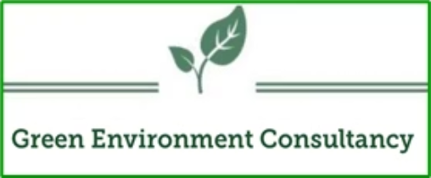
Sustainability & Green Building Certification
We guide organizations toward internationally recognized sustainability certifications that enhance property value, reduce operational costs, and demonstrate environmental leadership. Our certification specialists navigate the complex requirements of LEED and GSAS systems, ensuring successful outcomes.
LEED Certification
GSAS Auditing
Complete LEED auditing and documentation support for all rating systems and certification levels.
Gulf-specific green building assessment and certification guidance aligned with regional climate.
Beyond certification, we develop comprehensive sustainability strategies that integrate energy efficiency, water conservation, and environmental technology into your operations, creating long-term value and competitive advantage in Kuwait's evolving market.
Sustainability Reporting
Efficiency Strategies
Comprehensive sustainability reports demonstrating environmental performance to stakeholders.
Customized energy and water efficiency strategies reducing costs and environmental footprint.
Technology Integration
Implementation of cutting-edge environmental technologies for monitoring and optimization.

Slide 9






Environmental Monitoring & Laboratory Services
Our state-of-the-art environmental monitoring and laboratory services provide the accurate, reliable data essential for regulatory compliance, environmental management, and informed decision-making. We employ advanced instrumentation and internationally recognized analytical methods.
Air Quality Monitoring
Noise Level Assessment
Comprehensive ambient and emissions monitoring for particulate matter, gases, and volatile organic compounds using calibrated instruments.
Environmental and occupational noise surveys with detailed analysis against Kuwait and international standards.
Water Quality Testing
Wastewater Analysis
Complete physical, chemical, and biological analysis of groundwater, surface water, and potable water sources.
Industrial and municipal wastewater characterization ensuring compliance with discharge standards and treatment effectiveness.
Soil Testing & Classification
Laboratory Reporting
Detailed soil analysis including contamination assessment, geotechnical properties, and agricultural suitability evaluation.
Professional laboratory reports with quality assurance documentation, chain of custody, and regulatory interpretation.

Slide 10
Full Regulatory Compliance Framework
Legal Foundation
Navigating Kuwait's environmental regulatory landscape requires specialized expertise and current knowledge of evolving requirements. Our team includes former KEPA officials who helped shape these regulations, providing unmatched insight into compliance expectations and enforcement practices.
We operate in complete alignment with Kuwait's environmental legislation:
Environmental Protection Law No. 42 of 2014
We help clients avoid costly violations, reduce environmental liability, and build positive relationships with regulatory authorities. Our proactive compliance strategies identify risks before they become problems, ensuring continuous regulatory adherence and operational confidence.
Amended by Law No. 99 of 2015
Our deep understanding of these regulations and their implementing decrees ensures clients achieve and maintain full compliance.
Violation Prevention
Risk Reduction
Proactive compliance audits preventing enforcement actions
Systematic identification and mitigation of environmental risks
Regulatory Liaison
Professional communication with KEPA and other authorities

Slide 11
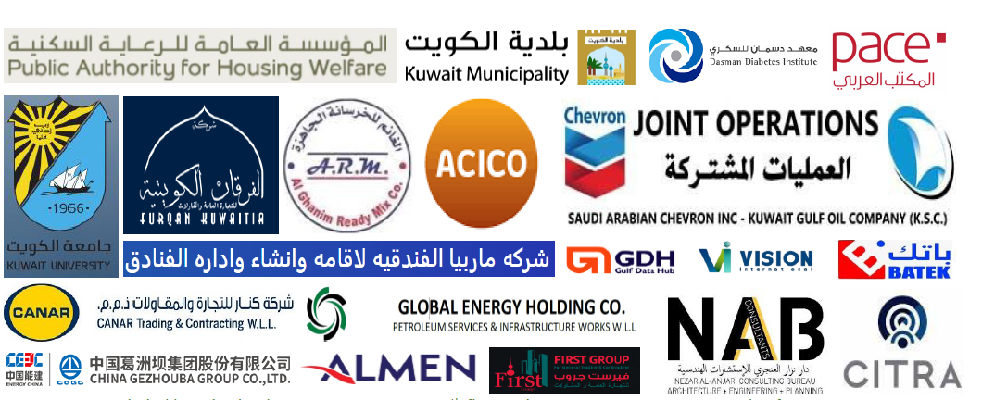
Strategic Partnerships
Our network of strategic partnerships extends our capabilities and ensures comprehensive service delivery across Kuwait and the Gulf region. These collaborations bring specialized expertise, advanced technologies, and regional reach to every project.
These partnerships enable us to deliver integrated solutions combining environmental consultancy with engineering design, laboratory analysis, construction services, and regional project execution. Together, we provide seamless, comprehensive environmental management.

Slide 12
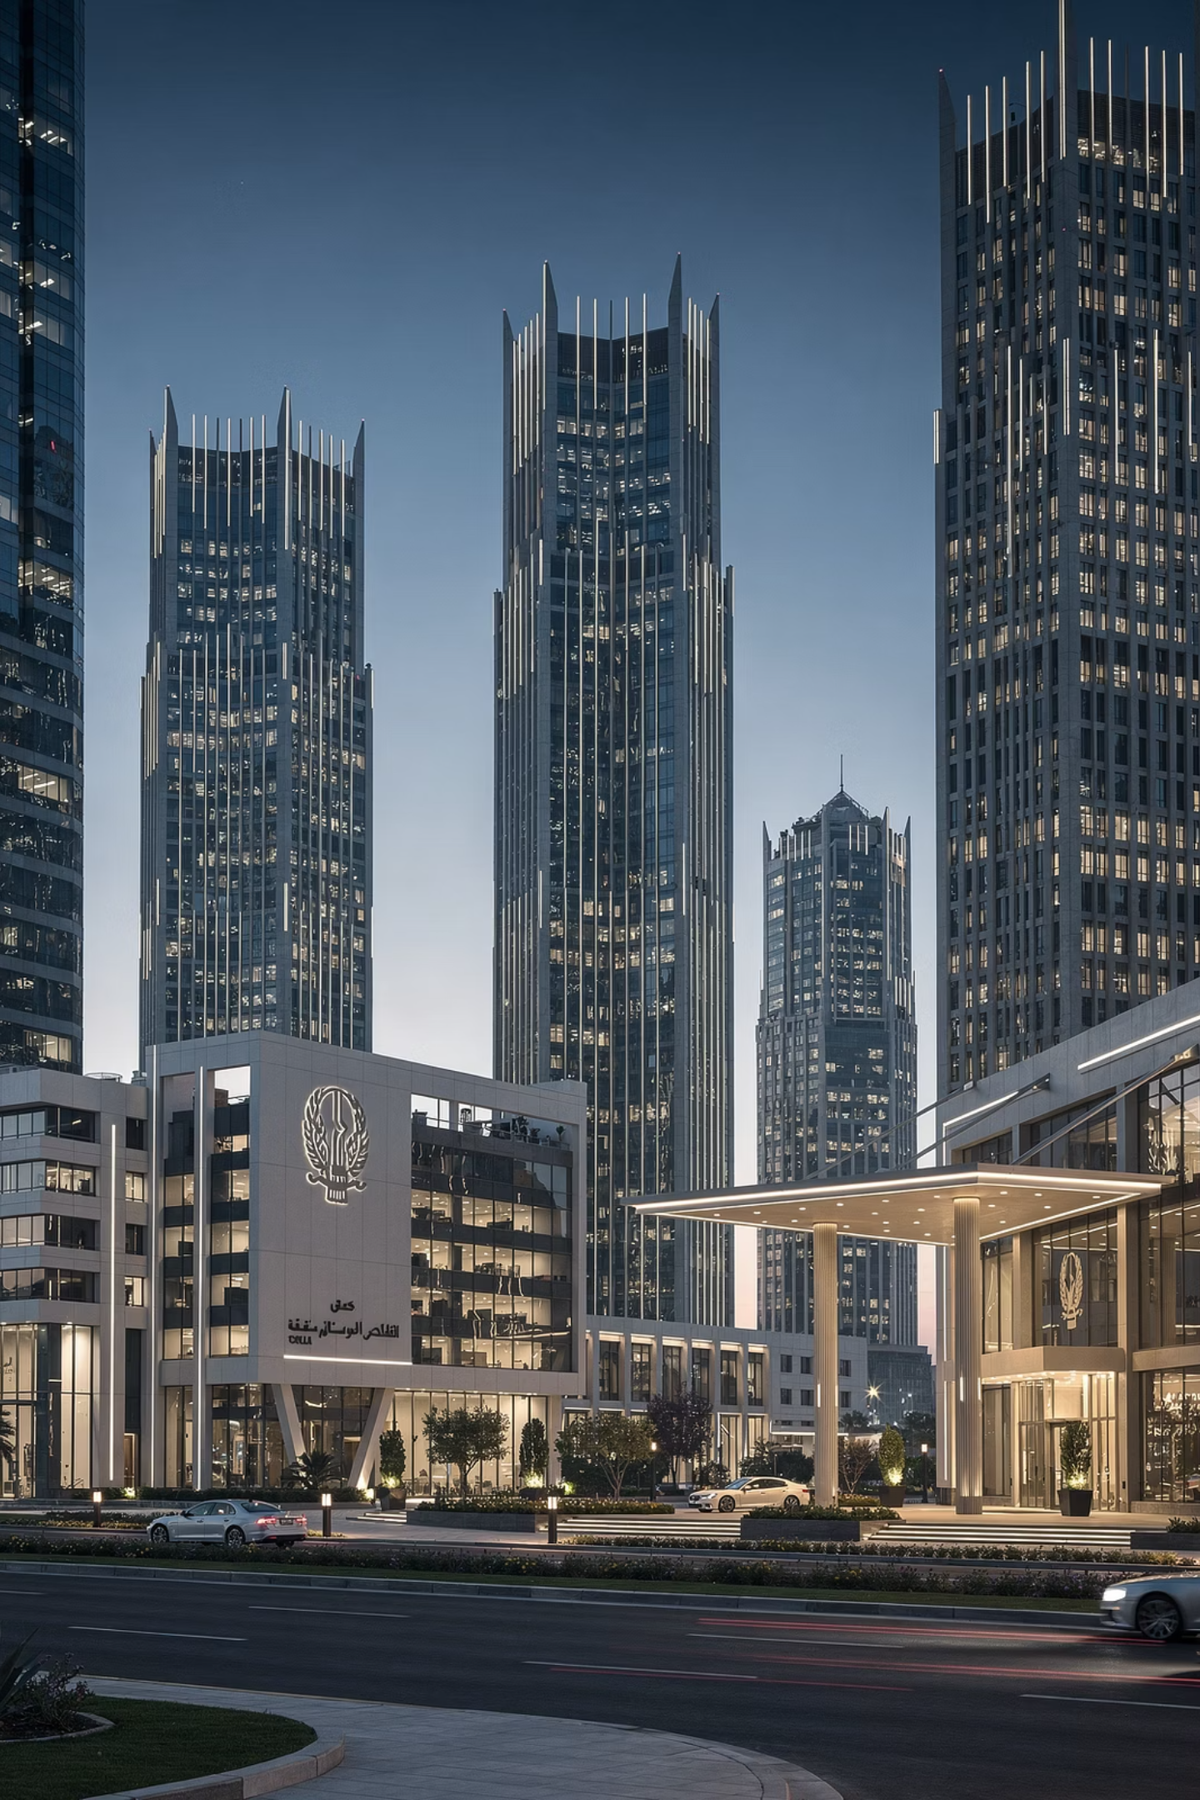

Trusted by Leading Organizations
During 2024-2025, we proudly served Kuwait's most prestigious government entities, international corporations, and hospitality leaders. Our diverse client portfolio demonstrates our ability to deliver excellence across all sectors and project scales.
Government & Public Sector
Hospitality & Commercial
Public Authority for Housing Welfare
Kuwait Municipality
Kuwait University
CITRA (Central Agency for Information Technology)
Marriott Hotels
Hilton Hotels
Sheraton Hotels
Crowne Plaza
Multiple commercial developments
Energy & Industrial
And many other governmental, industrial, and commercial entities across Kuwait requiring environmental excellence and regulatory compliance.
Chevron Joint Operations
SLB (Schlumberger)

Slide 13
Quality Management & International Certification
ISO 14001:2015
ISO 45001:2018
Environmental Management System
Occupational Health & Safety Management
Internationally recognized certification demonstrating our systematic approach to environmental management, continuous improvement, and commitment to minimizing our own environmental footprint while helping clients manage theirs.
Global standard certification ensuring the highest levels of workplace safety, health protection, and risk management in all our operations and the services we deliver to clients.
These certifications reflect our unwavering commitment to international standards of quality, safety, and environmental responsibility. Our management systems undergo regular third-party audits, ensuring continuous compliance and improvement in how we serve our clients.

Slide 14




Why Choose Green Environment Consultancy
Grade (A) KEPA Approved
Former KEPA Leadership
Deep Regulatory Knowledge
Multidisciplinary Expertise
Highest level of environmental consultancy registration, qualified for all project types and complexities.
Unique advantage of leadership team with direct KEPA authority experience and regulatory development expertise.
Unmatched understanding of Kuwait's environmental laws, regulations, and enforcement practices.
Comprehensive team covering all environmental disciplines from assessment through implementation and monitoring.
Proven Track Record
Compliance Focus
Extensive portfolio serving government, industrial, and commercial sectors with consistent excellence.
Proactive approach ensuring full regulatory compliance and comprehensive risk mitigation for client operations.

Slide 15
Our Commitments to You
Client Satisfaction
Industry Recognition
Unwavering Professionalism
Environmental Excellence
We measure success by your satisfaction. Every project receives dedicated attention, responsive communication, and solutions tailored to your specific needs and constraints. Your success is our success.
We maintain our position as Kuwait's leading environmental consultancy through continuous innovation, professional development, and delivery of results that set industry benchmarks for quality and compliance.
We are passionate advocates for environmental protection. Our solutions balance regulatory compliance with practical implementation, economic viability, and genuine environmental benefit for Kuwait and future generations.
Our work reflects the highest standards of professional ethics, technical competence, and integrity. We deliver honest assessments, practical recommendations, and transparent reporting you can trust.

Slide 16


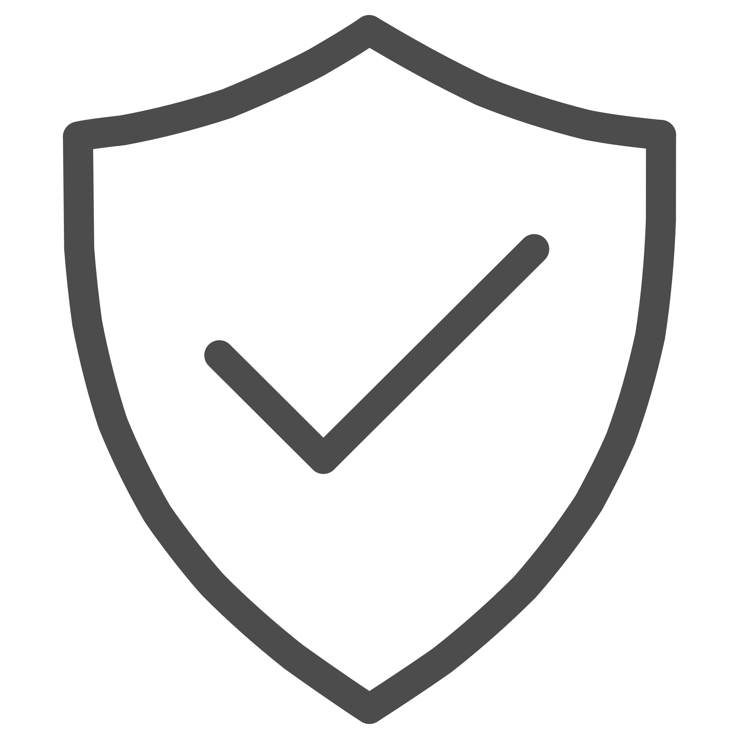

Start Your Project Today
Green Environment Consultancy
Building Kuwait's Sustainable Future
Mazaya Tower 1, 15th Floor
Kuwait City, Kuwait
Phone: +965 22245887
Mobile: +965 95575534 - +965 92232178
Email: info@envo-green.com
Together, we create environmental solutions that protect our environment, ensure regulatory compliance, and enable sustainable economic growth for Kuwait.
Website: www.envo-green.com
Let's discuss how we can support your environmental goals and ensure your project's success.
ENVIRONMENTAL EXCELLENCE
REGULATORY COMPLIANCE
GRADE A CERTIFIED

